Slide 1
ReactJS
Balakrishna Ragala

Slide 2


Slide 3
Lets make this interactive – ask, know, say, comment, suggest, laugh, learn, feel, see, do

Slide 4
create-react-app
Notes:
Transpiler ( ES6 -> ES5 )
Dependent Libraries
Debug Tools

Slide 5
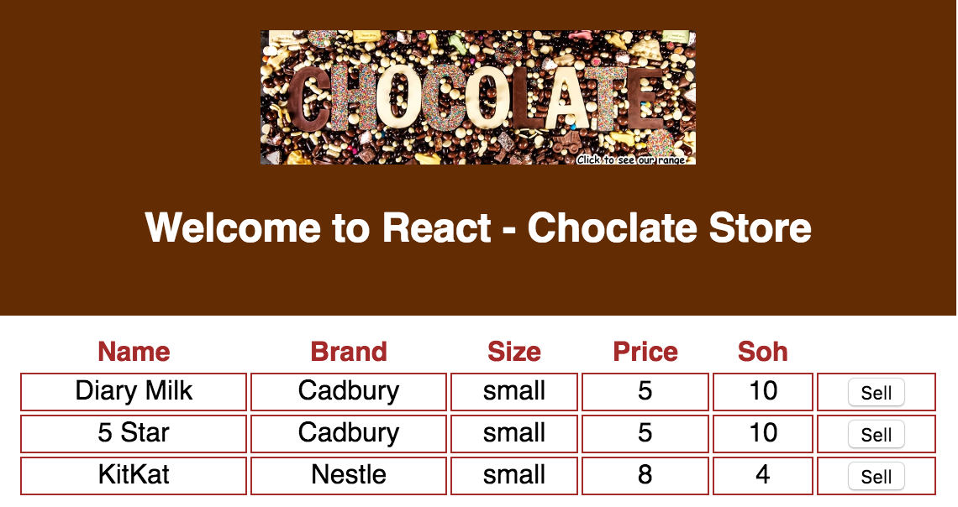
Notes:
Step-1

Slide 6
Notes:
Render expects to return single element -> always a single return element
Step-0

Slide 7
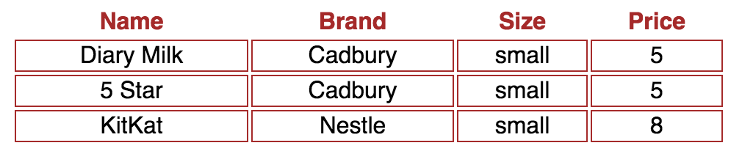
Notes:
Step-1

Slide 8
{this.props}
Notes:
Step-2

Slide 9
<Table> vs <table>
Notes:
HTML tags vs React components
JSX uses this convention to differentiate between the local component classes and HTML tags
Self closing tag

Slide 10
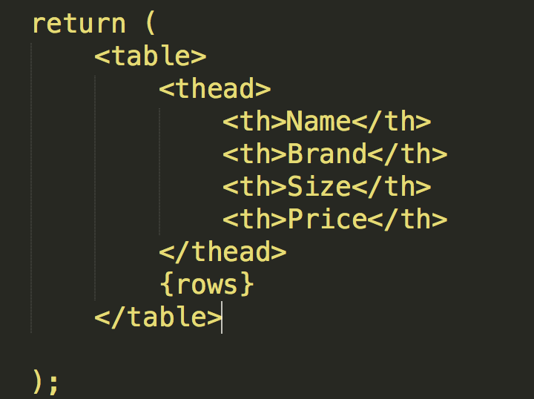
Improve this

Slide 11
{}
Notes:
Guess what are we discussing now
JavaScript expressions
child expressions -> {rows}
Step-3

Slide 12
comments in JSX ??
Notes:
{/* This is a comment */}

Slide 13
{?:}
Notes:
Step-4

Slide 14
handleClick
Notes:
Step-5

Slide 15
this.state={}
this.setState({msg:”recact”})
this.getState()
Notes:
step-5

Slide 16
propTypes
Notes:
Step-6

Slide 17
defaultProps
Notes:
Step-7

Slide 18
props vs state
Notes:
Props are passed when a component gets instantiated.
State is something that can change over time. Therefore, changes in state affect the rendering of components.
state as some sort of private data structure of the component.
Props are immutable
State is something internal and private to the component

Slide 20
ʇunoWๅๅıMʇuəuodɯoɔ
ʇunoWpıႧʇuəuodɯoɔ
(sporPtxen tcejbo)sporPevieceRlliWtnenopmoc
boolean shouldComponentUpdate(object nextProps, object nextState)
componentWillUpdate(object nextProps, object nextState)
componentDidUpdate(object prevProps, object prevState)
)(tnuomnUlliWtnenopmoc
React.unmountComponentAtNode(document.body)
Notes:
componentWillMount
componentDidMount
componentWillReceiveProps(object nextProps)
boolean shouldComponentUpdate(object nextProps, object nextState)
componentWillUpdate(object nextProps, object nextState)
componentDidUpdate(object prevProps, object prevState)
componentWillUnmount()
React.unmountComponentAtNode(document.body)

Slide 21
When render is called?

Slide 22
return false
Notes:
Return false for shouldComponentUpdate
Show react dev tool

